Slide 1
Functions From Formulas
College Algebra

Slide 2
How To – Evaluate a Function From a Formula
Substitute the input variable in the formula with the value provided.
Calculate the result.

Slide 3
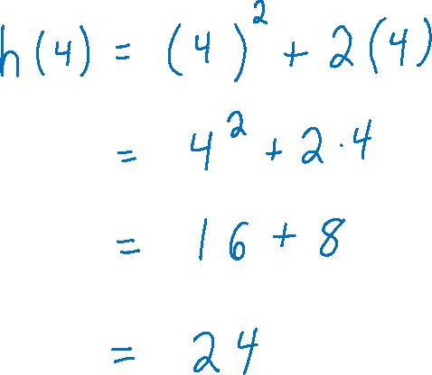



Example 1
Given the function $$h\left(p\right)=p^{2}+2p,$$ evaluate $h(4)$.

Slide 4
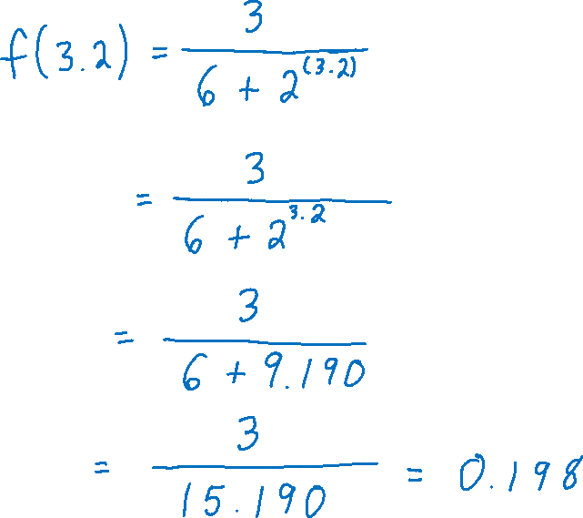



Example 2
Given the function $$f\left(x\right)=\frac{3}{6+2^{x}},$$ evaluate $f(3.2)$.

Slide 5
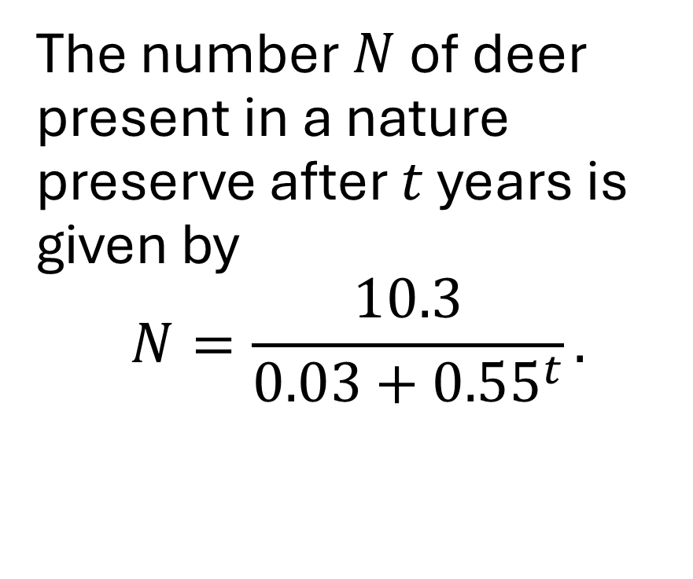
Example 3
The number $N$ of deer present in a nature preserve after $t$ years is given by $$N=\frac{10.3}{0.03+{0.55}^{t}}.$$

Slide 6
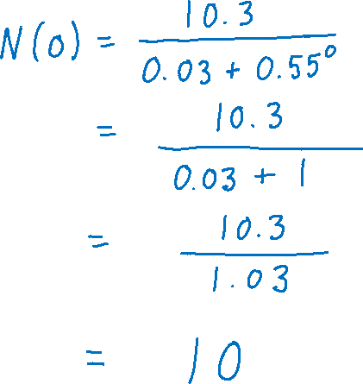


Example 3a
How many deer were initially at the preserve?
The number $N$ of deer present in a nature preserve after $t$ years is given by $$N=\frac{10.3}{0.03+{0.55}^{t}}.$$

Slide 7



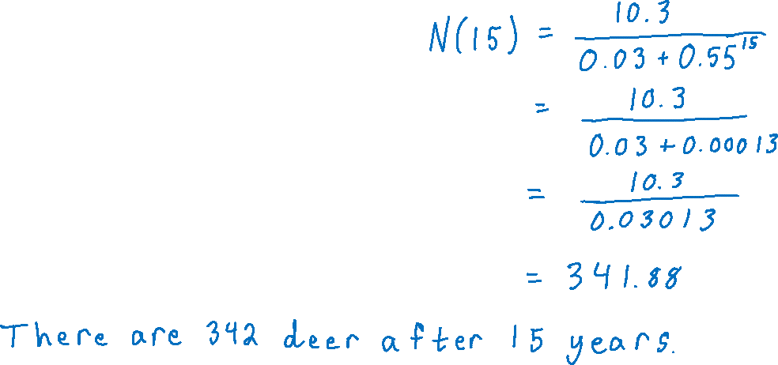
Example 3b
Evaluate $N(15)$ and explain the meaning.
The number $N$ of deer present in a nature preserve after $t$ years is given by $$N=\frac{10.3}{0.03+{0.55}^{t}}.$$

Slide 8

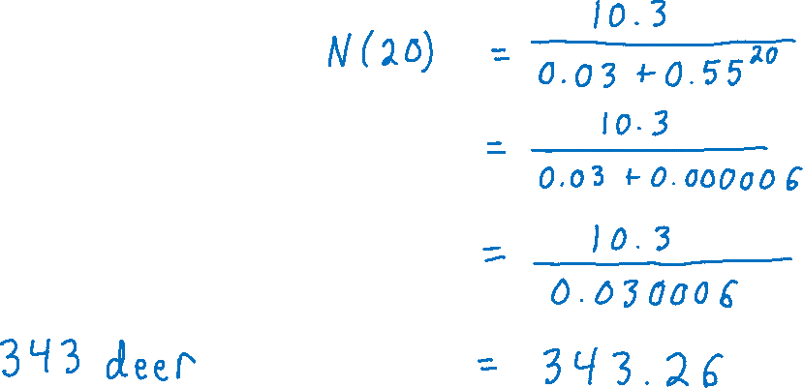



Example 3c
Express the number of deer after 20 years in function notation. Then calculate that value.
The number $N$ of deer present in a nature preserve after $t$ years is given by $$N=\frac{10.3}{0.03+{0.55}^{t}}.$$

Slide 9
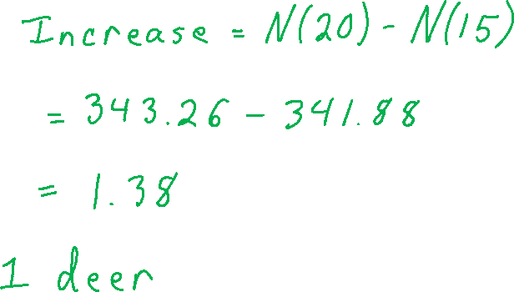


Example 3d
How much did the deer population increase from the 15th year to the 20th year?
The number $N$ of deer present in a nature preserve after $t$ years is given by $$N=\frac{10.3}{0.03+{0.55}^{t}}.$$

